Slide 1
LEARNING
Learning is the process of acquiring new, or modifying existing, knowledge, behaviors, skills, values, or preferences.
A relatively permanent change in behavior through past experiences.(Walker,1967)

Slide 2
Habituation
Our response to unchanging stimuli decrease over time. This is aspect of adaption is a simple form of learning called Habituation.
Sensitization
A simple form of learning, appears as an increase in responsiveness to a stimulus.
Habitation and sensitization Provide organisms with useful way to adapt to their environment.

Slide 3
Learning theories
Associative learning theories are based on behaviorism where the stimulus-response relationship and the influence of environment are considered as the major sources of learning .

Slide 4
Learning theories
The cognitive learning theories involve the thinking process and understandings.
cognitive learning theory is based on the cognitive model of human behavior, i.e. it emphasizes on the free will and positive aspects of human behavior.
Cognition refers to the individual’s thoughts, feelings, ideas, knowledge and understanding about himself and the environment.
Thus, an organism applies this cognition in learning which results in not merely the response to a stimulus, but the application of internal image of the external environment, so as to accomplish the goal.

Slide 5
BEHAVIOUR THEORIES ↓
Classical Conditioning
Operant Conditioning

Slide 6
Theory of Classical Conditioning
CONDITIONING: The modification of a natural response through artificial means is called conditioning
A learning process that occurs when two stimuli are repeatedly paired: a response which is at first elicited by the second stimulus is eventually elicited by the first stimulus alone.

Slide 7
BACKGROUND:
IVAN PAVLOV proposed the theory of classical conditioning.
A Russian Physiologist
Studying the process of digestion in animals
Conducting experiments on dogs

Slide 8
EXPERIMENT:
He fitted some pipes in the mouth of the dog to observe saliva secretion by seeing and smelling the food. he also arranged a bell. When the food was presented the bell also rang. he did this for many times i.e whenever He brought the food ,before entering the room,he rang the bell.since here he changed the natural stimulus(food) with an artificial means(bell).he named this phenomenon as CONDITIONING

Slide 9
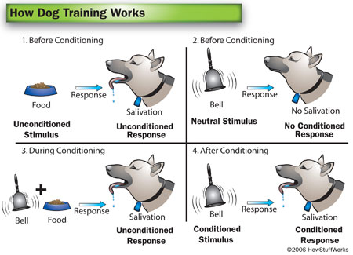

Slide 10
CONCLUSION OF HIS THEORY
THE theory of classical conditioning states that when a neutral stimulus is associated with a meaningful or natural stimulus, it produces a similar response as for the meaningful stimulus i.e
UCS UCR
After Many times repeated
UCS + CS CR
CS CR

Slide 11
Classical Conditioning Terminology
1.) Unconditioned Stimulus (US)- The stimulus that evokes a natural response. (food)
2.) Unconditioned Response (UR)- The natural reaction to the unconditioned stimulus. (salivation)
3.) Conditioned Stimulus (CS)- Previously neutral stimulus that, through conditioning, evokes conditioned response. (bell)
4.) Conditioned Response (CR)- Learned reaction to conditioned stimulus that occurs because of previous conditioning (salivation to bell)

Slide 12
Principles of classical conditioning
Acquisition
This term refers to the learning of the conditioned response
GENERALIZATION
A new stimulus similar to the learnt conditioned stimulus will also elicit the same conditioned response.
Eg, dog salivates on other bells
DISCRIMINATION
The organism learns to respond towards particular stimulus and not towards all
Eg the dog learns the specific bell which follows food.

Slide 13
Principles of classical conditioning
EXTINCTION
Extinction means the weakening of the conditioned response in the absence of the unconditioned stimulus.
Eg, dog stops salivation if the bell doesn’t follow the food.
Spontaneous recovery
it means that he conditioned response appears again without further conditioning.
Extinction is not permanent.
Eg. the dog relearns the same response if presented the same stimulus in less time.

Slide 14
Theory of Operant Conditioning
The operant conditioning is also called instrumental conditioning.
Major contributors are B.F SKINNER and E.L THORNDIKE.
The OPERANT BEHAVIOR means the voluntary behavior with choices.
The OPERANT CONDITIONING is a form of learning where the consequences of a behavior produce changes in the probability of the behavior occurrence.
In classical conditioning ,there is S-R bond whereas in operant stimulus is related to the response along with the end result. if result is good we will repeat the behavior if bad we will avoid it in both cases learning occurs.

Slide 15
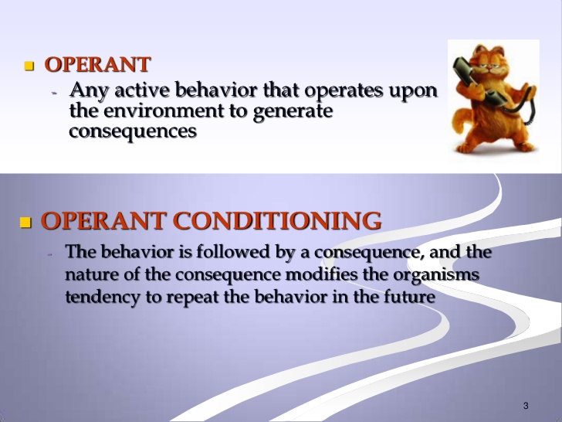

Slide 16
Experiment
He put a rat in a closed box called skinner box. A hook in the box was fitted so that as soon as it was touched , a piece of food was dropped in the box . Skinner recorded the movements of the rate through mechanical means in order to have objective measurement. The experiment was too successful that at later stages he found the rat only touching the hook for getting food, without random movements.
These experiments support the law of effect by Thorndike.

Slide 17
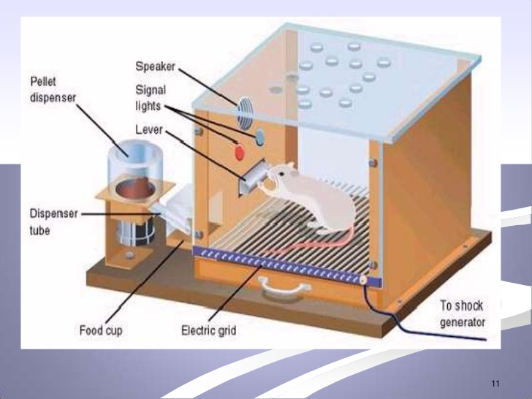

Slide 18
Thorndike’s Law of effect
E,L Thorndike proposed his law of effect, according to which behaviors followed by positive outcomes are strengthened whereas the behaviors followed by negative outcomes are weakened.

Slide 19
Operant conditioning
Learning occurs as a result of consequences.
the component of learning expend to include a key characteristics:
Reinforcement
Punishment

Slide 20
Reinforcement
Reinforcement is a term refer to anything that increases the likelihood that a response will occur.
Reinforcement is defined by the effect that it has on behavior—it increases or strengthens the response.

Slide 21
Types of Reinforcement
In operant conditioning, there are two different types of reinforcement. Both of these forms of reinforcement influence behavior, but they do so in different ways.
Positive reinforcement involves adding something to increase a response, such as giving a bit of candy to a child after she cleans up her room.
Negative reinforcement involves removing something in order to increase a response, such as canceling a quiz if students turn in all of their homework for the week. By removing the aversive stimulus (the quiz), the teacher hopes to increase the desired behavior (completing all homework).

Slide 22
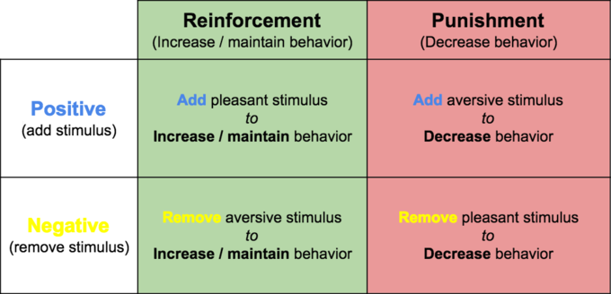

Slide 23
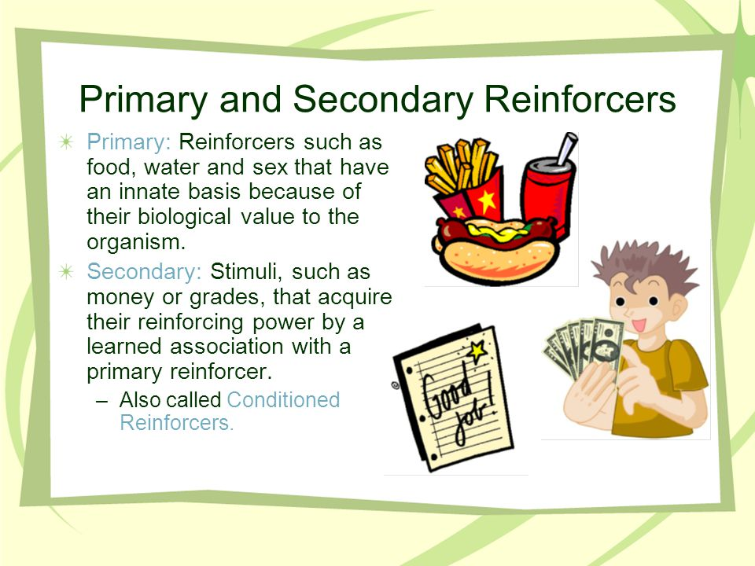

Slide 24
Schedule of Reinforcement
A schedule of reinforcement is a rule stating when and how often a behavior will be reinforced.
This is applicable when you are purposely trying to train and reinforce an action

Slide 25
Types of reinforcement schedules
A). Continuous Reinforcement
the desired behavior is reinforced every single time it occurs. Generally, this schedule is best used during the initial stages of learning in order to create a strong association between the behavior and the response.
B).Partial Reinforcement the response is reinforced only part of the time.
1. Fixed-ratio schedules
2.Variable- ratio schedules
3. Fixed-interval schedules
4. Variable-interval schedules

Slide 26
Schedules of partial reinforcement:
1. Fixed-ratio schedules are those where a response is reinforced only after a specified number of responses.
2.Variable- ratio schedules occur when a response is reinforced after an unpredictable number of responses.
3. Fixed-interval schedules are those where the first response is rewarded only after a specified amount of time has elapsed.
4. Variable-interval schedules occur when a response is rewarded after an unpredictable amount of time has passed

Slide 27
Punishment
Punishment is a kind of stimulus that aims to decrease the strength in behaviour due to its consequence. Punishment is the presentation of an adverse event or outcome that causes a decrease in the behavior it follows. There are two kinds of punishment:
Positive punishment, sometimes referred to as punishment by application, presents an unfavorable event or outcome in order to weaken the response it follows. Spanking for misbehavior is an example of punishment by application.
Negative punishment, also known as punishment by removal, occurs when a favorable event or outcome is removed after a behavior occurs. Taking away a child's video game following misbehavior is an example of negative punishment.

Slide 28
Negative punishment is more effective if:
• It immediately follows a response.
• It is applied consistently.

Slide 29
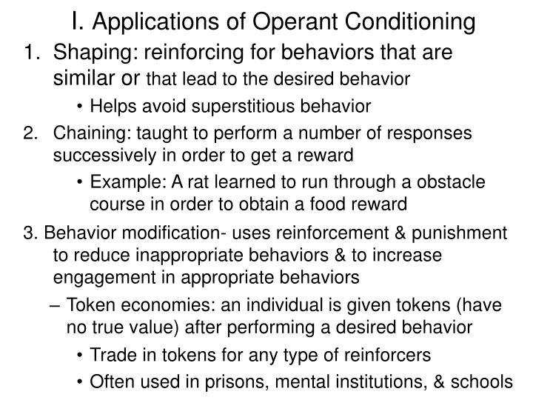

Slide 30
cognitive learning
The cognitive learning theories involve the thinking process and understandings.
cognitive learning theory is based on the cognitive model of human behavior, i.e. it emphasizes on the free will and positive aspects of human behavior.
Cognition refers to the individual’s thoughts, feelings, ideas, knowledge and understanding about himself and the environment.
Thus, an organism applies this cognition in learning which results in not merely the response to a stimulus, but the application of internal image of the external environment, so as to accomplish the goal.

Slide 31
Cognitive Learning Theory
Edward Tolman has contributed significantly to the Cognitive Learning Theory.
According to him, individuals not only responds to stimuli but also act on beliefs, thoughts, attitudes, feelings and strive towards goals.
In other words, An individual creates a cognitive map in his mind, i.e. an image of the external environment, preserves and organizes information gathered, as a result of the consequences of events encountered during the learning process. Thus, the organism learns about the event and objects on the basis of a meaning assigned to stimuli.

Slide 32
cognitive learning theory is based on the cognitive model of human behavior, i.e. it emphasizes on the free will and positive aspects of human behavior.
Cognition refers to the individual’s thoughts, feelings, ideas, knowledge and understanding about himself and the environment. Thus, an organism applies this cognition in learning which results in not merely the response to a stimulus, but the application of internal image of the external environment, so as to accomplish the goal.

Slide 33
Tolman has conducted an experiment to elucidate the cognitive learning theory. He trained a rat to turn right in the ‘T’ maze in order to obtain food. One day, he started a rat from the opposite part of the maze, according to the operant conditioning theory, the rat should have turned right due to the past conditioning, but instead, it turned towards where the food was kept.
Thus, Tolman concluded that rat formed a cognitive map in its mind to figure out where the food has been placed, and reinforcement was not a precondition for learning to take place.

Slide 34
Cognitive process in learning comes from research on learned helplessness, latent learning, cognitive maps, insight and observational learning.

Slide 35
Learned helplessness
Learned helplessness, a tendency to give up any effort to control the environment.
Learning that responses do not affect consequences, resulting in failure to try exert control over environment.

Slide 36
Latent learning
Latent learning is a type of learning which is not apparent in the learner's behavior at the time of learning, but which manifests later when a suitable motivation and circumstances appear.
While you might have learned how to cook a roast by watching your parents prepare dinner, this learning may not be apparent until you find yourself having to cook a meal on your own.
But not all learning is immediately apparent. Sometimes learning only becomes evident when we need to utilize it.

Slide 37
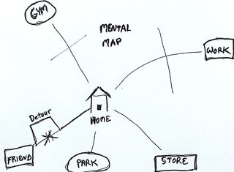
Cognitive map
A mental representation of the environment.

Slide 38
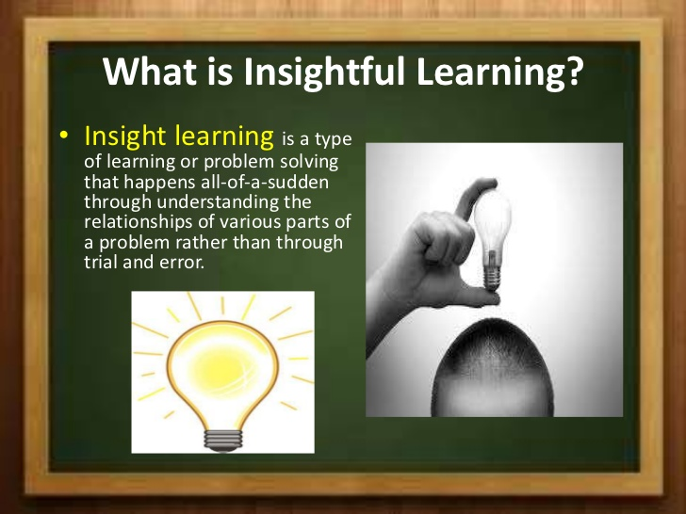

Slide 39
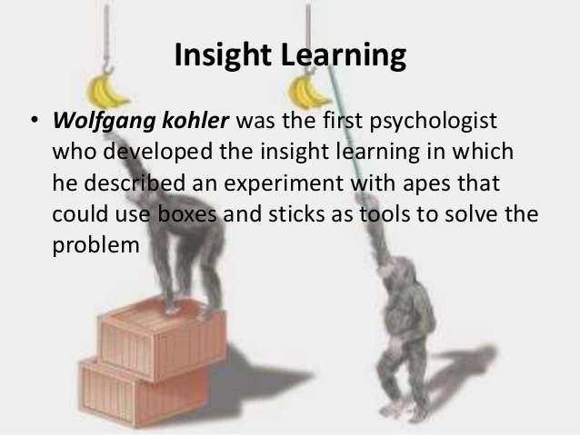

Slide 40
Köhler placed a chimpanzee named Sultan inside a cage. Sultan grew hungry and a bunch of banana was placed just outside the cage. Sultan was provided with one long and another short bamboo stick. Neither of the sticks could reach the banana alone and the only possible way to reach the banana was to join the two sticks.
Initially, Sultan showed all customary reactions that a chimpanzee shows inside a cage, and gradually tried to draw the banana towards him with the sticks. After countless fruitless efforts, Sultan nearly gave up, but as he was playing with the sticks, he managed to touch the banana by pushing a stick with another stick. Sultan accidentally managed to join the two sticks and with its help, it pulled the banana inside the cage. Sultan immediately grabbed the banana when faced with the same problem next day.

Slide 41
characteristics of Insight Learning
Insight leads to change in perception.
Insight is sudden.
With insight, the organism tends to perceive a pattern or organization (that helps in learning).
Understanding plays important role n insight learning.
Insight is related with higher order animals and not with inferior animals.
Age influences insight learning. Adults are better learner than children.
Past experience and perceptual organization is important in perception.

Slide 42
Observational learning/ social learning
The process of learning by watching others is called observational learning or social learning.
Some observational learning occurs through vicarious experience, in which an individual is influenced by seeing or hearing about the consequences of others’ behaviour.

Slide 43
Albert Bandura
Bandura claimed that “in social situations, people often learn much more rapidly simply by observing the behaviors of others”
Bandura found that there are four components of observational learning:
  Attentional Processes
  Retention Processes
  Motor Reproduction Processes
  Reinforcement and Motivational Processes

Slide 44
Attentional Processes
One cannot imitate a model without paying attention to the model.
A model is often attractive because of the qualities he or she posses. These qualities such as prestige, power, and success gain the attention of the observer and begin the process of observational learning.

Slide 45
Retention Processes
Retention process is the way one remembers the model’s actions so he can imitate them.
Bandura explains, “In order to reproduce social behavior when the model is no longer present to serve as a guide, the response patterns must be represented in memory in symbolic form.
Example: mentally rehearsing the actions or practicing the actions will help one remember what he learned.

Slide 46
Motor Reproduction Processes
This is when a person uses the proper motor skills to accurately reproduce their model.
A five year old can observe his parent operate a car, but this does not mean he has the ability to correctly drive an automobile

Slide 47
Reinforcement and Motivational Processes
This process refers to the idea that a child will be more likely to imitate a behavior if he is likely to gain a reward
“When positive incentives are introduced, observational learning that previously remained unexpressed is likely to emerge in action.”

Slide 48
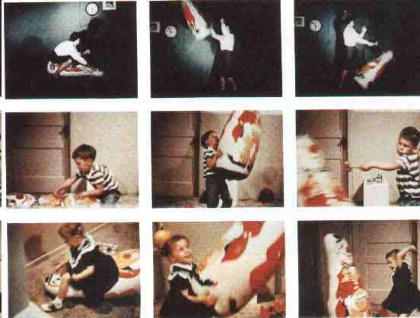
Bobo Doll Experiment

